Slide 1
Algoritma Analizi Uygulama-2
11.11.2024

Slide 2
Soru 1: Inversion Problem
Let A[0..n − 1] be an array of n distinct real numbers.
A pair (A[i], A[j]) is said to be an inversion if these numbers are out of order, i.e., i<j but A[i]>A[j].
Design (nlogn) efficiency algorithm for counting the number of inversions.

Slide 3
Soru 1: Inversion Problem
Example:
Input: A[]={7, 5, 9, 3, 4}
Output: 7
Explanation Inversions are: (7, 5), (7, 3), (7, 4), (5, 3), (5, 4) (9, 3) (9, 4)
Example:
Input: A[]={6, 3, 2}
Output: 3
Explanation Inversions are: (6, 3), (6, 2), (3, 2)

Slide 4
Soru 1: Inversion Problem
merge-and-sort:
Input: A: sorted list
B: sorted list
BEGIN
i, j, count := 0
C := []
WHILE i < Length(A) AND j < Length(B) DO
IF B[j] < A[i] THEN
count := count + (length(A) - i)
C.append(B[j])
j := j + 1
ELSE
C.append(A[i])
i := i + 1
END IF
END WHILE
append the remainder of the list to C
RETURN count, C
END
sort-and-count:
Input: L: list
BEGIN
IF Length(L) = 1 THEN
RETURN 0, L
ELSE
divide L into A,B
(rA, A) := sort-and-count(A)
(rB, B) := sort-and-count(B)
(r, L) := merge-and-count(A,B)
END IF
inv := rA+rB+r
return inv, L
END

Slide 5
Soru 2: Nuts and Bolts Problem
You are given a collection of n bolts of different widths and n corresponding nuts.
You are allowed to try a nut and bolt together, from which you can determine whether the nut is larger than the bolt, smaller than the bolt, or matches the bolt exactly. However, there is no way to compare two nuts together or two bolts together.
The problem is to match each bolt to its nut.
Design an algorithm for this problem with efficiency in (n log n).

Slide 6
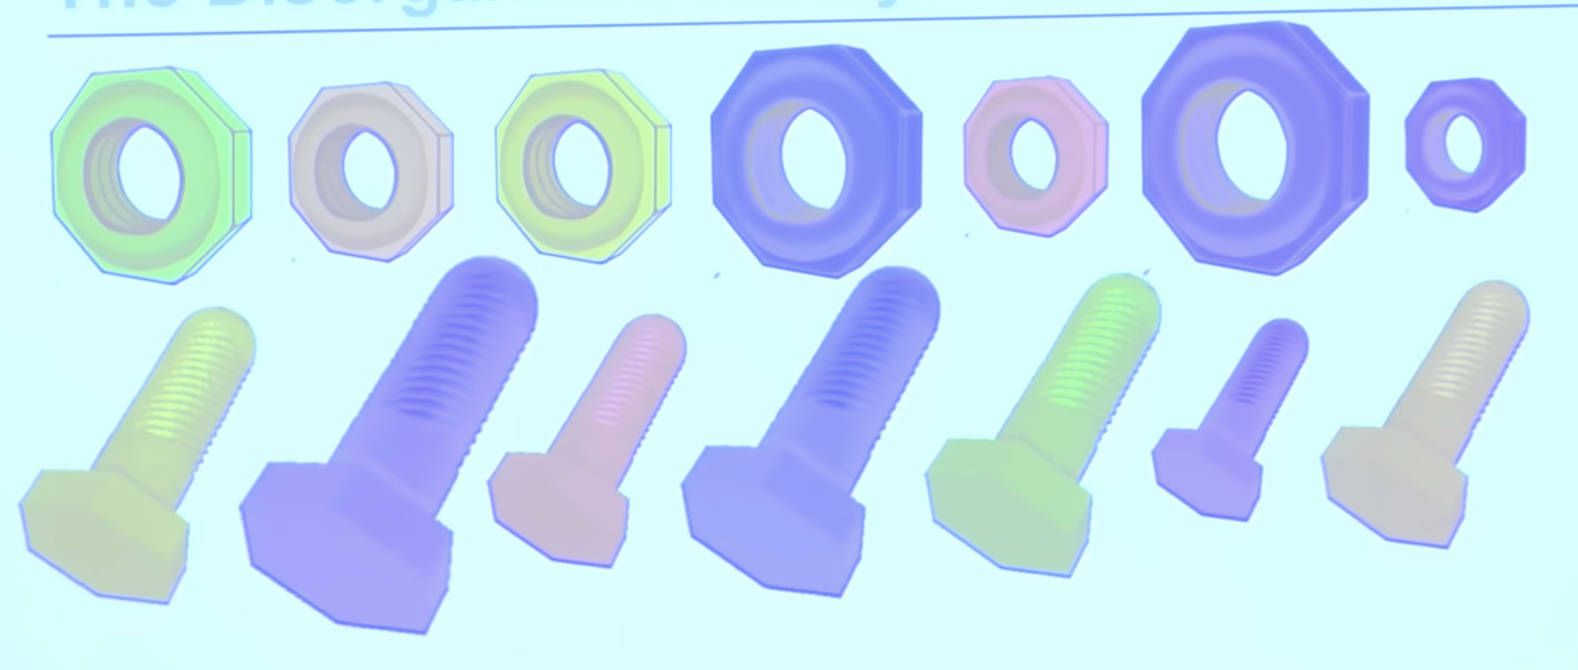
Soru 2: Nuts and Bolts Problem
Example:
Input: The lists of locks and keys.
nuts = { ),@,*,^,(,%, !,$,&,#}
bolts = { !, (, #, %, ), ^, &, *, $, @ }
Output: After matching nuts and bolts:
nuts: ! # $ % & ( ) * @ ^
bolts: ! # $ % & ( ) * @ ^

Slide 7
Soru 2: Nuts and Bolts Problem
partition:
Input: Array: list
low, high, pivot = int
BEGIN
i := low
FOR j in range low to high DO
IF array[j] < pivot THEN
SWAP array[i], array[j]
i := i+1
ELSE IF array[j] = pivot THEN
SWAP array[j], array[high]
j := j-1
END IF
END FOR
SWAP array [i], array[j]
RETURN i
END
nut-and-bolt-match:
Input: nuts, bolts: list
low, high = int
BEGIN
pivotLoc := partition(nuts, low, high, bolts[high])
partition(bolts, low, high, nuts[pivotLoc])
nut-and-bolt-match(nuts, bolts, low, pivotLoc-1)
nut-and-bolt-match(nuts, bolts, pivotLoc + 1, high)
END

Slide 8
Soru 3: Hashing
Havalimanında yolcular tarafından unutulan eşyalar görevliler tarafından kayıp eşya biriminde depolanmaktadır. Bu birim, yolcuların unuttukları eşyaları bulduklarında kolayca geri alabilmeleri için tasarlanmalıdır. Görevliler depoladıkları yüzlerce eşyaya kolay ve hızlı bir şekilde erişebilmek istemektedir. Kaybolan eşyalara numara vererek depolayıp yolcular aramaya geldiklerinde hızlıca bulmayı amaçlamaktadır. Görevliler, kaybolan eşyaları takip etmek için bir hash tablosu oluşturmak istemektedir. Önce, belirli bir büyüklüğe sahip bir tablo oluşturulmalı ve eşyaların kimlik numaraları hash işlemine tabi tutulmalıdır.
Kayıp eşyaların ufak bir listesi “30,20,56,75,31,19” şeklindedir.
Linear Probing
Quadratic Probing
Double Hashing
Yukarıdaki yöntemler ile eşyaları hash deposuna yerleştiriniz.

Slide 9
hashFunction:
Input: val: hashed value
RETURN val%11
hashing:
Input: inputArr: Array of values being hashed
hashArray: Hash map
FOR EACH value IN inputArr
hashValue := CALL hashFunction(value)
WHILE hashArray[hashValue] is not EMPTY DO
hashValue := (hashValue+1) % Length(hashArray)
ENDWHILE
hashArray[hashValue] := value
ENDFOR

Slide 10
hashing:
Input: inputArr: Array of values being hashed
hashArray: Hash map
FOR EACH value IN inputArr
hashValue := CALL hashFunction(value)
hashQuad := 1
WHILE hashArray[hashValue] is not EMPTY DO
hashValue := (hashValue+hashQuad*hashQuad)%Length(hashArray)
hashQuad := hashQuad+1
ENDWHILE
hashArray[hashValue] := value
ENDFOR
hashFunction:
Input: val: hashed value
RETURN val%11

Slide 11
hashing:
Input: inputArr: Array of values being hashed
hashArray: Hash map
FOR EACH value IN inputArr
hashValue := CALL hashFunction1(value)
hashQ := 1
WHILE hashArray[hashValue] is not EMPTY DO
hashValue := (hashValue+hashQ* (CALL hashFunction2(value))) % Length(hashArray)
hashQ := hashQ+1
ENDWHILE
hashArray[hashValue] := value
ENDFOR
hashFunction1:
Input: val: hashed value
RETURN val%11
hashFunction2:
Input: val: hashed value
RETURN 1+ val%7

Slide 12
hashSearch:
Input: hashArray: Hash map
searchedVal: Value searched in hash map
hashValue:= CALL hashFunction(searchedVal)
queryCount := 1
WHILE queryCount != Length(hashArray) AND hashArray[hashValue] is not EMPTY AND hashArray[hashValue] != searchedVal DO
hashValue := hashValue+1
queryCount := queryCount+1
IF hashValue = Length(hashArray) THEN
hashValue := 0
ENDIF
ENDWHILE
IF hashArray[hashValue] = searchedVal THEN
RETURN hashValue
ELSE
RETURN -1
ENDIF

Slide 13
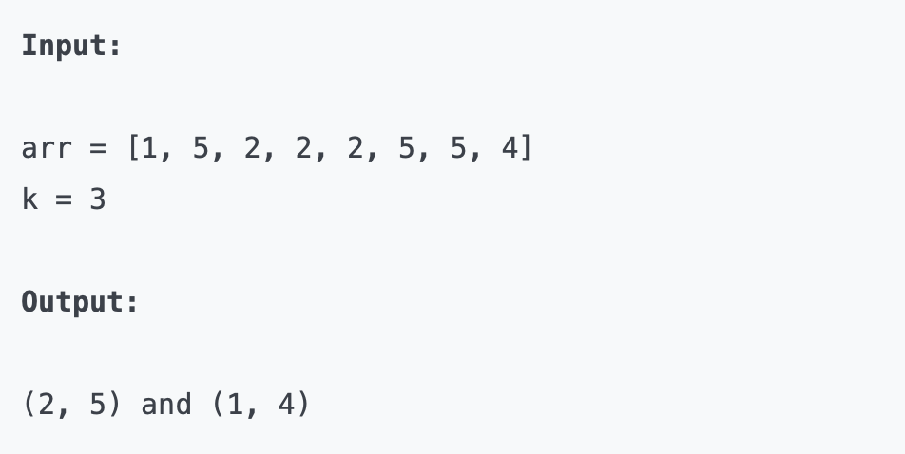
Soru 4: Find pairs with difference `k` in an array
Brute force?
Hashing?

Slide 14
findkDistancePairs:
Input: arr: Original Array
hashMap: hash map of input arr
k: distance searched for
pairs = Empty array
FOR EACH val IN arr
res := CALL hashSearch(hashArray,val-k)
IF res != -1 THEN
IF (val,val-k) is not in pairs THEN
pairs append (val,val-k)
ENDIF
ENDIF
res := CALL hashSearch(hashArray,val+k)
IF res !=-1 THEN
IF (val,val+k) is not in pairs THEN
pairs append (val,val+k)
ENDIF
ENDIF
RETURN pairs

Slide 15
Soru 5: Searching in text
“i know that that is the correct answer” cümlesinde arama yapınız.

Slide 16
hashing:
Input: inputArr: Array of values being hashed
hashArray: Hash map
FOR EACH value IN inputArr
hashValue := CALL hashFunction(value)
WHILE hashArray[hashValue] is not EMPTY DO
hashValue := hashValue+1
IF hashValue = Length(hashArray) THEN
hashValue := 0
ENDIF
ENDWHILE
hashArray[hashValue] := value
ENDFOR
hashFunctionLetters:
Input: word: hashed value
base := 13
hash := 0
FOR i 0 to Length(word)
hash := hash+ char*base**(Length(word)-i-1)
RETURN hash%Length(word)

Slide 17
Soru 6: Perceptual Hashing
Convert the image to grayscale
Downsize to a 9x9 square of gray values (or 17x17 for a larger, 512-bit hash)
Calculate the “row hash”: for each row, move from left to right, and output a 1 bit if the next gray value is greater than or equal to the previous one, or a 0 bit if it’s less (each 9-pixel row produces 8 bits of output)
Calculate the “column hash”: same as above, but for each column, move top to bottom
Concatenate the two 64-bit values together to get the final 128-bit hash

Slide 18




Slide 19
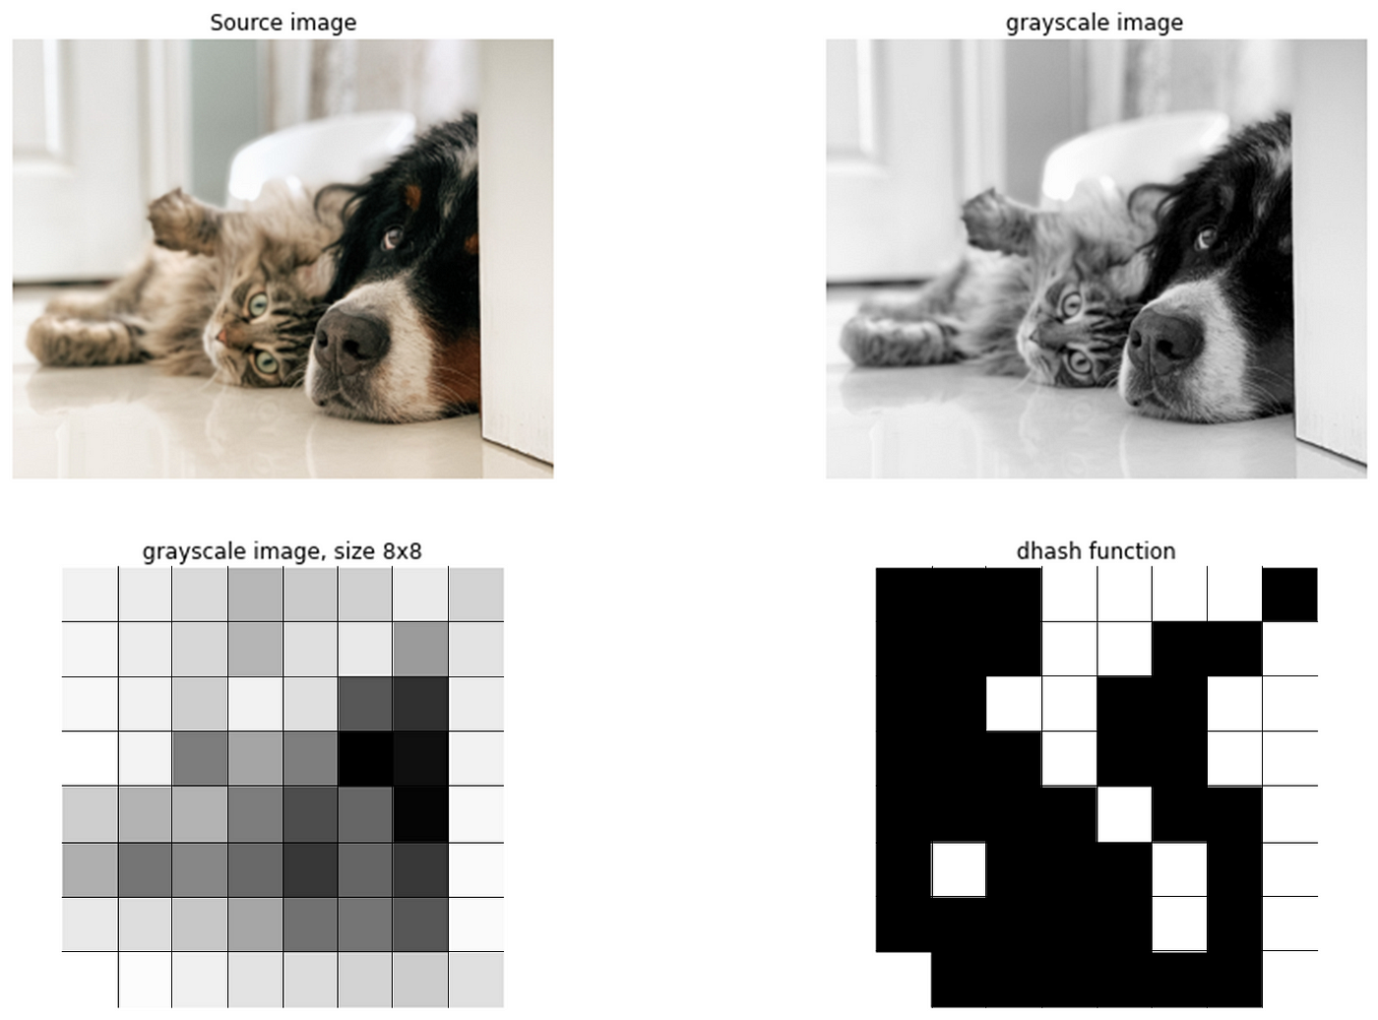
Image hash = 0001111000011001001100110001001100001001010001010000010110000001

